Slide 1
Intro to DataFrames and Spark SQL
Big Data Programming
Module 2- Lecture 3
Data frames & SQL

Slide 2
Write Less Code: High-Level Operations
Solve common problems concisely using Data Frame functions:
Selecting columns and filtering
Joining different data sources
Aggregation (count, sum, average, etc.)
Plotting results (e.g., with Pandas)
2

Slide 3
What are DataFrames?
DataFrames are a recent addition to Spark (early 2015).
The DataFrames API:
Is intended to enable wider audiences beyond “Big Data” engineers to leverage the power of distributed processing
Is inspired by data frames in R and Python (Pandas)
Designed from the ground-up to support modern big data and data science applications
An extension to the existing RDD API
3

Slide 4
What are DataFrames?
DataFrames have the following features:
Ability to scale from kilobytes of data on a single laptop to petabytes on a large cluster
Support for a wide array of data formats and storage systems
State-of-the-art optimization and code generation through the Spark SQL Catalyst optimizer
Seamless integration with all big data tooling and infrastructure via Spark
APIs for Python, Java, Scala, and R
4

Slide 5







Construct a DataFrame
# Construct a DataFrame from a "users" table in Hive. df = sqlContext.table("users")
# Construct a DataFrame from a log file in S3.
df = sqlContext.load("s3n://someBucket/path/to/data.json", "json")
val people = sqlContext.read.parquet("...")
DataFrame people = sqlContext.read().parquet("...")
5

Slide 6


Use DataFrames
# Create a new DataFrame that contains only "young" young = users.filter(users["age"] < 21)
users
# Alternatively, using a Pandas-­‐like syntax young = users[users.age < 21]
# Increment everybody's age young.select(young["name"],
by 1
young["age"] + 1)
users by gender
# Count the number of young
young.groupBy("gender").count()
# Join young users with another DataFrame, logs young.join(log, logs["userId"] == users["userId"],
"left_outer")
6

Slide 7


DataFrames and Spark SQL
young.registerTempTable("young") sqlContext.sql("SELECT count(*) FROM young")
7

Slide 8
DataFrames and Spark SQL
DataFrames are fundamentally tied to Spark SQL.
The DataFrames API provides a programmatic interface really, a domain-specific language (DSL) for interacting with your data.
Spark SQL provides a SQL-like interface.
What you can do in Spark SQL, you can do in Data frames … and vice versa.
8

Slide 9
What, exactly, is Spark SQL?
Spark SQL allows you to manipulate distributed data with SQL queries. Currently, two SQL dialects are supported.
If you're using a Spark SQLContext, the only supported dialect is "sql", a rich subset of SQL 92.
If you're using a HiveContext, the default dialect is "hiveql", corresponding to Hive's SQL dialect. "sql" is also available, but "hiveql" is a richer dialect.
9

Slide 10
Spark SQL
You issue SQL queries through a SQLContext or
HiveContext, using the sql() method.
The sql() method returns a DataFrame.
You can mix DataFrame methods and SQL queries in the same code.
To use SQL, you must either:
query a persisted Hive table, or
make a tablealias for a DataFrame, using
registerTempTable()
10

Slide 11
DataFrames
Like Spark SQL, the DataFrames API assumes that the data has a table-like structure.
Formally, a DataFrame is a size-mutable, potentially heterogeneous tabular data structure with labeled axes (i.e., rows and columns).
Just think of it as a table in a distributed database: a distributed collection of data organized into named, typed columns.
11

Slide 12
Transformations, Actions, Laziness
DataFrames are lazy. Transformations contribute to the query plan, but they don't execute anything.
Actions cause the execution of the query.
Transformation examples
filter
select
drop
intersect
join
Action examples
count
collect
show
head
take
12

Slide 13
Data frames & Resilient Distributed Datasets (RDDs)
Data frames are built on top of the Spark RDD* API.
This means you can use normal RDD operations on Data frames.
However, stick with the Data frame API, wherever possible.
Using RDD operations will often give you back an RDD, not a Data frame.
The Data frame API is likely to be more efficient, because it can optimize the underlying operations with Catalyst.
13

Slide 14
DataFrames can be significantly faster than RDDs. And they perform the same, regardless of language.
DataFrame SQL
DataFrame R DataFrame Python DataFrame Scala RDD Python
RDD Scala
0 2 4 6 8
Time to aggregate 10 million integer pairs (in seconds)
10

Slide 15
Creating a DataFrame
You create a Data frame with SQLContext
object (or one of its descendants)
In the Spark Scala shell (spark-shell) or pyspark, you have a SQLContext available automatically, as sqlContext.
In an application, you can easily create one yourself, from SparkContext.
The Data frame data source API is consistent, across data formats.
“Opening” a data source works pretty much the same way, no matter what.

Slide 16


Creating a DataFrame
conf = SparkConf().setAppName(appName).setMaster(master) sc = SparkContext(conf=conf)
sqlContext = SQLContext(sc)
df = sqlContext.read.parquet("/path/to/data.parquet") df2 = sqlContext.read.json("/path/to/data.json")

Slide 17
SQLContext and Hive
Our previous examples created a default Spark
SQLContext object.
If you're using a version of Spark that has Hive support, you can also create a HiveContext, which provides additional features, including:
The ability to write queries using the more complete HiveQL parser
Access to Hive user-defined functions
The ability to read data from Hive tables

Slide 18

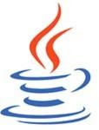



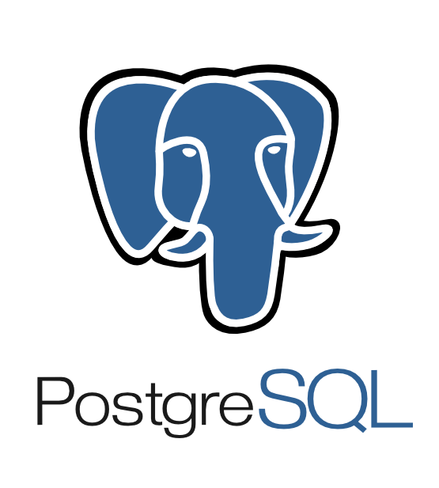








Data Sources supported by DataFrames
built-in
external
JDBC
{ JSON }
and more …
50

Slide 19
What can I do with a DataFrame?
Once you have a DataFrame, there are a number of operations you can perform.
Let’s look at a few of them.
But, first, let’s talk about columns.

Slide 20
Columns
When we say “column” here, what do we mean?
A Data frame column is an abstraction. It provides a common column-oriented view of the underlying data, regardless of how the data is really organized.

Slide 21
Columns
Input Source Format | Data Frame Variable Name | Data
JSON | dataFrame1 | [ {"first": "Amy", "last": "Bello", "age": 29 }, {"first": "Ravi", "last": "Agarwal", "age": 33 }, … ]
CSV | dataFrame2 | first,last,age Fred,Hoover,91 Joaquin,Hernandez,24 …
SQL Table | dataFrame3
Data Frame columns map onto some common data sources.
first | last | age
Joe | Smith | 42
Jill | Jones | 33

Slide 22
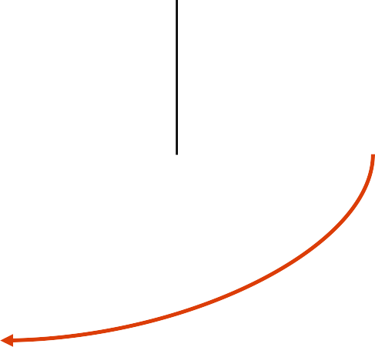











Columns
dataFrame1
column: "first"
Input Source Format | Data Frame Variable Name | Data
JSON | dataFrame1 | [ {"first": "Amy", "last": "Bello", "age": 29 }, {"first": "Ravi", "last": "Agarwal", "age": 33 }, … ]
CSV | dataFrame2 | first,last,age Fred,Hoover,91 Joaquin,Hernandez,24 …
SQL Table | dataFrame3 | first last age Joe Smith 42 Jill Jones 33
dataFrame2
column: "first"
dataFrame3
column: "first"

Slide 23
Columns
When we say “column” here, what do we mean?
Several things:
A place (a cell) for a data value to reside, within a row of data. This cell can have several states:
empty (null)
missing (not there at all)
contains a (typed) value (non-null)
A collection of those cells, from multiple rows
A syntactic construct we can use to specify or target a cell (or collections of cells) in a Data frame query

Slide 24


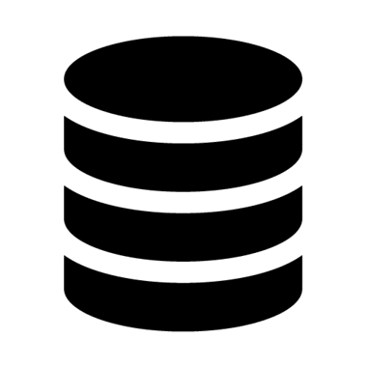
select()
You can also use SQL. (This is the Python API, but you issue SQL the same way in Scala and Java.)
In[1]: df.registerTempTable("names")
In[2]: sqlContext.sql("SELECT
show(5)
+-­‐-­‐-­‐-­‐-­‐-­‐-­‐-­‐-­‐-­‐+-­‐-­‐-­‐+-­‐-­‐-­‐-­‐-­‐+
|first_name|age| _c2|
+-­‐-­‐-­‐-­‐-­‐-­‐-­‐-­‐-­‐-­‐+-­‐-­‐-­‐+-­‐-­‐-­‐-­‐-­‐+
first_name, age, age > 49 FROM
names").\
| | Erin| | 42|false|
| | Claire| | 23|false|
| | Norman| | 81| true|
| | Miguel| | 64| true|
| | Rosalita| | 14|false|
+-­‐-­‐-­‐-­‐-­‐-­‐-­‐-­‐-­‐-­‐+-­‐-­‐-­‐+-­‐-­‐-­‐-­‐-­‐+

Slide 25


filter()
In[1]: df.filter(df['age'] > 49).\
select(df['first_name'], df['age']).\ show()
+-­‐-­‐-­‐-­‐-­‐-­‐-­‐-­‐-­‐+-­‐-­‐-­‐+
|firstName|age|
+-­‐-­‐-­‐-­‐-­‐-­‐-­‐-­‐-­‐+-­‐-­‐-­‐+
| Norman| 81|
| Miguel| 64|
| Abigail| 75|
+-­‐-­‐-­‐-­‐-­‐-­‐-­‐-­‐-­‐+-­‐-­‐-­‐+

Slide 26
filter()
Here’s the SQL version.
In[1]:
SQLContext.sql("SELECT
"WHERE
first_name, age FROM names " + \ age > 49").show()
+-­‐-­‐-­‐-­‐-­‐-­‐-­‐-­‐-­‐+-­‐-­‐-­‐+
|firstName|age|
+-­‐-­‐-­‐-­‐-­‐-­‐-­‐-­‐-­‐+-­‐-­‐-­‐+
| Norman| 81|
| Miguel| 64|
| Abigail| 75|
+-­‐-­‐-­‐-­‐-­‐-­‐-­‐-­‐-­‐+-­‐-­‐-­‐+

Slide 27
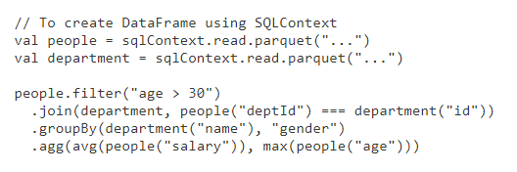
Filter()
Scala Example

Slide 28



orderBy()
in Python:
In [1]: df.filter(df['age'] > 49).\
select(df['first_name'], df['age']).\
orderBy(df['age'].desc(), df['first_name']).show()
+-­‐-­‐-­‐-­‐-­‐-­‐-­‐-­‐-­‐-­‐+-­‐-­‐-­‐+
|first_name|age|
+-­‐-­‐-­‐-­‐-­‐-­‐-­‐-­‐-­‐-­‐+-­‐-­‐-­‐+
| Norman| 81|
| Abigail| 75|
| Miguel| 64|
+-­‐-­‐-­‐-­‐-­‐-­‐-­‐-­‐-­‐-­‐+-­‐-­‐-­‐+

Slide 29


groupBy()
Often used with count(), groupBy() groups data items by a specific column value.
In [5]: df.groupBy("age").count().show()
+-­‐-­‐-­‐+-­‐-­‐-­‐-­‐-­‐+
|age|count|
+-­‐-­‐-­‐+-­‐-­‐-­‐-­‐-­‐+
| | 39| | 1|
| | 42| | 2|
| | 64| | 1|
| | 75| | 1|
| | 81| | 1|
| | 14| | 1|
| | 23| | 2|

Slide 30
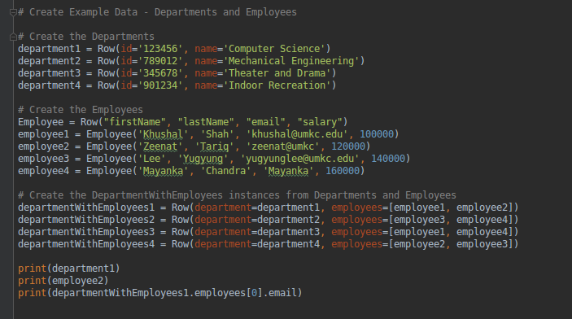
Create Data Frames

Slide 31
Continued …

Slide 32
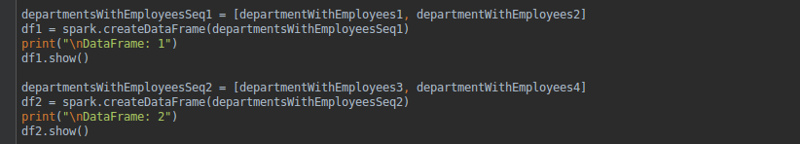
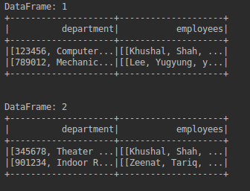
Create Data Frame from list of rows

Slide 33

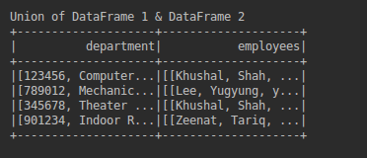
Union of Data Frames

Slide 34
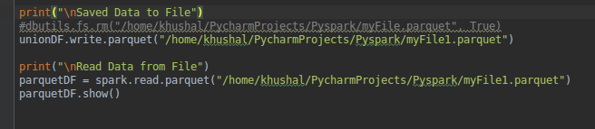
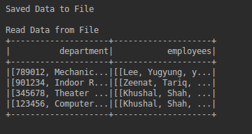
Read and Write to File

Slide 35

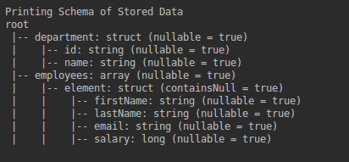
Print Schema of Data Frame

Slide 36

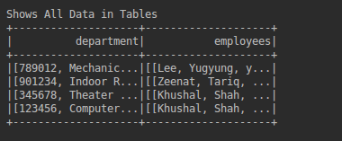
SQL Query on Data Frames

Slide 37
References
https://spark.apache.org/docs/latest/sql-programming-guide.html
https://spark.apache.org/docs/2.2.0/sql-programming-guide.html
https://www.tutorialspoint.com/spark_sql/spark_sql_dataframes.htm
https://spark.apache.org/docs/1.6.3/api/java/org/apache/spark/sql/DataFrame.html

